Slide 1
Manipal University Jaipur B. Tech. (Branch) III Year (V Semester) Session: 2021-22
Project Title:
Predicting used car prices
Submitted By: Bonthu Sai Saketh – 199301131
Atla Bharath Kumar Reddy- 199301231
Submitted To: Dr.Shalini puri
Group No. G2 Asst. Professor (Sr. Scale)

Slide 2
Abstract
Determining whether the listed price of a used car is a challenging task, due to the many factors that drive a used vehicle’s price on the market.
The focus of this project is developing Neural network models that can accurately predict the price of a used car based on its features, in order to make informed purchases.
We implement and evaluate various learning methods on a dataset consisting of the sale prices of different makes and models across cities in India. Different cities have different price of cars, which depends on the taxes and other factors

Slide 3
Literature Review
There are two primary phases in the system:
Training phase: The system is trained by using the data in the data set and fits a model (line/curve) based on the algorithm chosen accordingly.
Testing phase: The system is provided with the inputs and is tested for its working. The accuracy is checked. And therefore, the data that is used to train the model or test it, is to be appropriate. The system is designed to detect and predict price of used car.

Slide 4
Problem Statement & Objective
The prices of new cars in the industry are fixed by the manufacturer with some additional costs incurred by the Government in the form of taxes. So, customers buying a new car can be assured of the money they invest to be worthy.
But due to the increased price of new cars and the incapability of customers to buy new cars due to the lack of funds, used cars sales are on a global increase. There is a need for a used car price prediction system to effectively determine the worthiness of the car using a variety of features.
Even though there are websites that offers this service, their prediction method may not be the best. Besides, different models and systems may contribute on predicting power for a used car’s actual market value. It is important to know their actual market value while both buying and selling

Slide 5
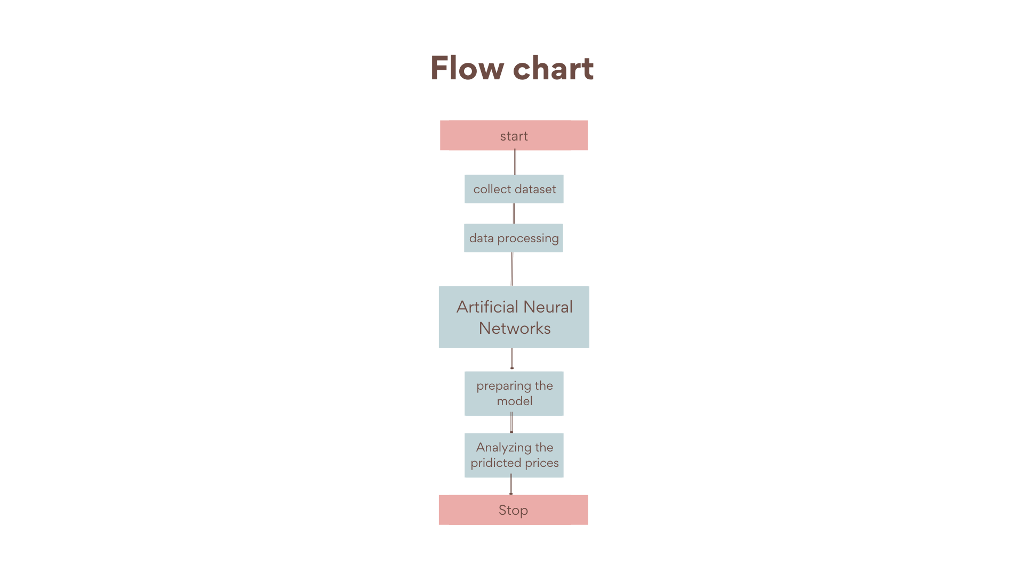
Proposed Approach

Slide 6
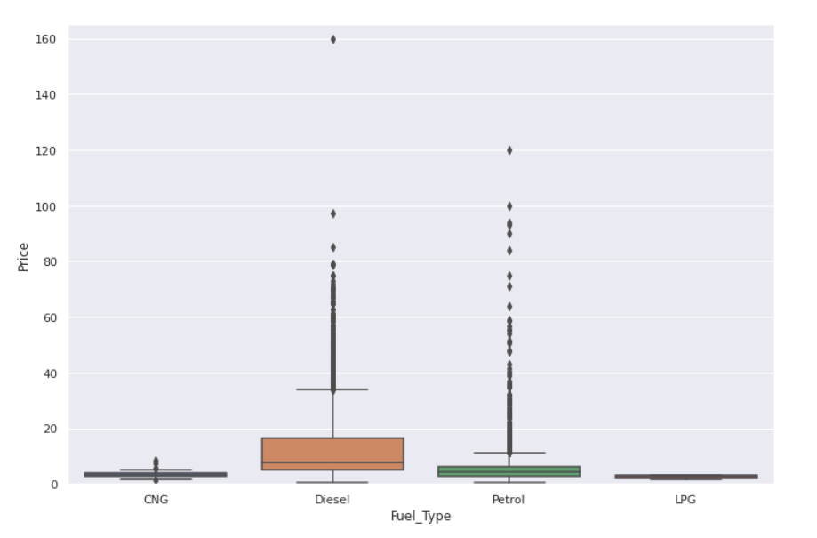
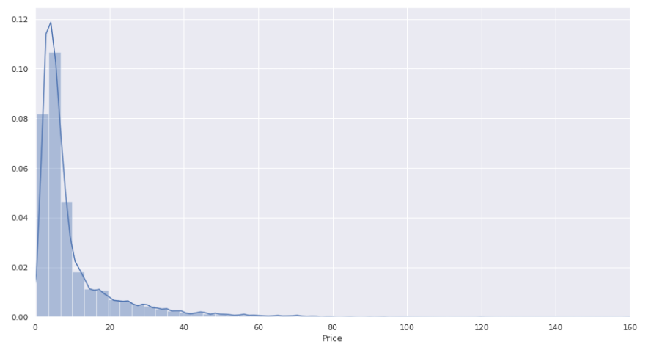
Data collection & Analysis

Slide 7
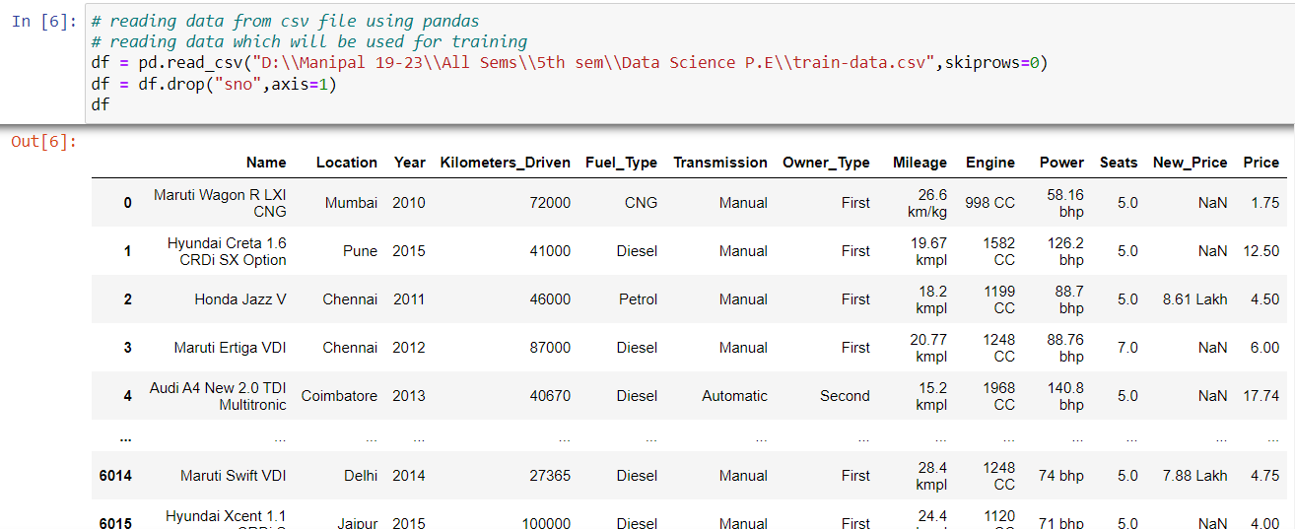
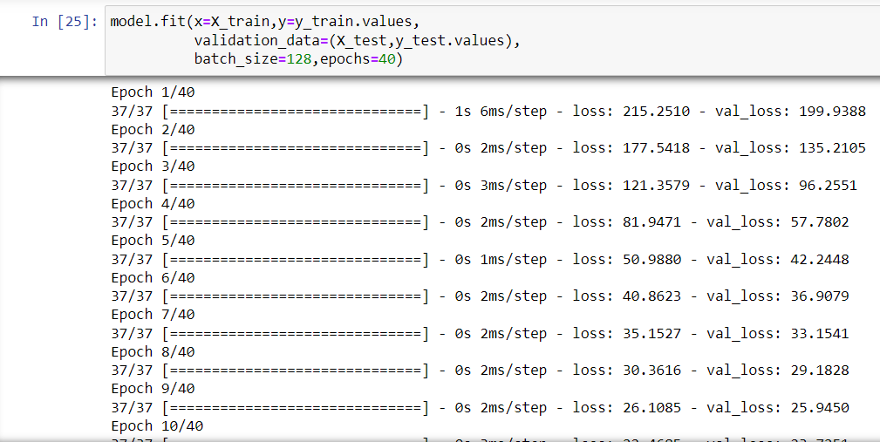
Experimental Setup & Variations

Slide 8
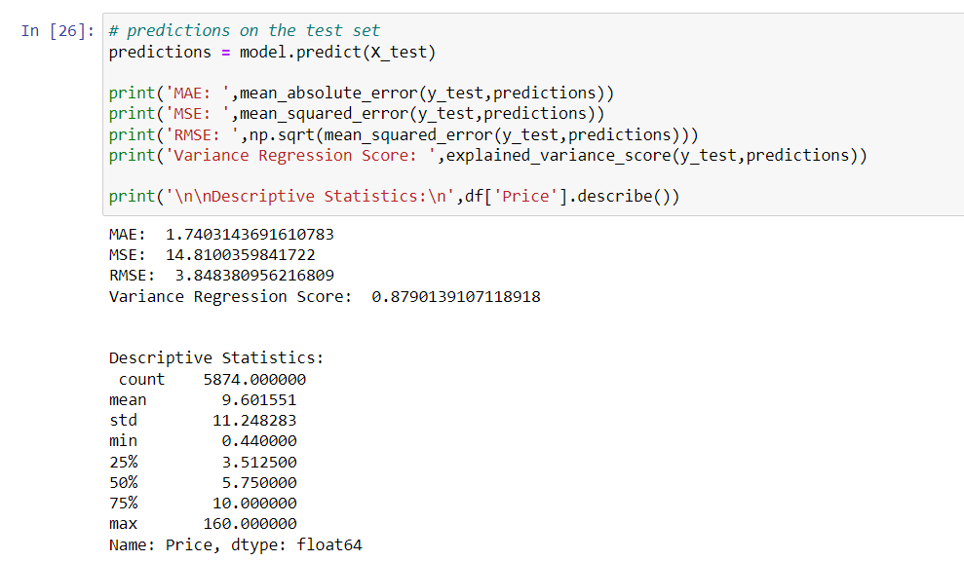
Results & Discussion

Slide 9
Conclusion and Future Scope
The increased prices of new cars and the financial incapability of the customers to buy them, Used Car sales are on a global increase. Therefore, there is an urgent need for a Used Car Price Prediction system which effectively determines the worthiness of the car using a variety of features. The proposed system will help to determine the accurate price of used car price prediction
In future this Neural network model may bind with various website which can provide real time data for price prediction. And we may add large historical data of car price which can help to improve accuracy of the Neural network model. We can build an android app as user interface for interacting with user.

Slide 10
References
[1] M. H. Dunham, “Data Mining: Introductory and Advanced Topics,” Pearson Education.
https://youtube.com/playlist?list=PLeo1K3hjS3uu7CxAacxVndI4bE_o3BDtO
neuronalenetze-en-zeta2-1col-dkrieselcom.pdf

Slide 11
Thank you

